Slide 1
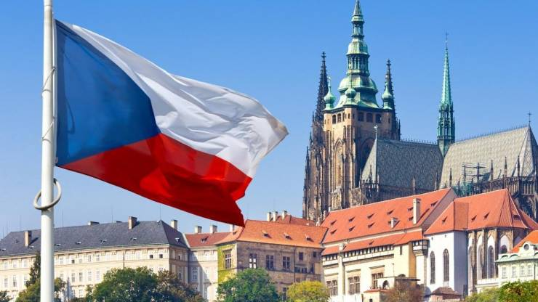
SOS: It´s time to take action against technology addiction
Presentation of
Business Academy Neveklov, Czechia
Created by students of BA Neveklov

Slide 2
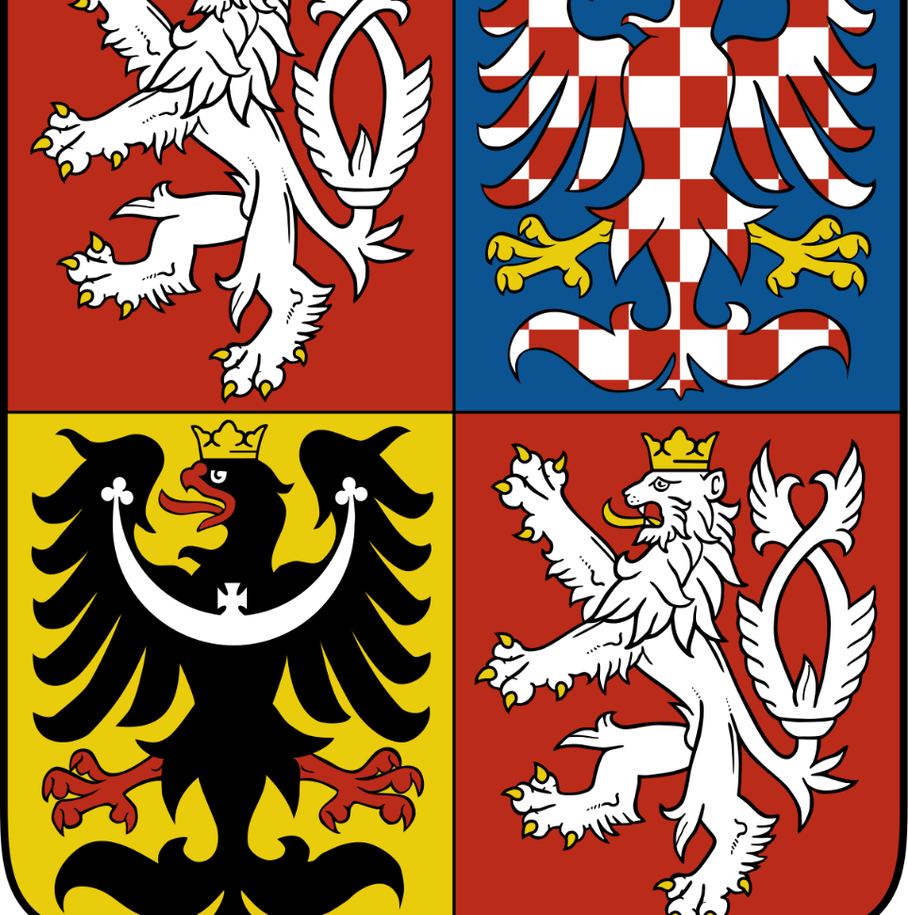
Czech Republic
A small country in the heart of Europe

Slide 3
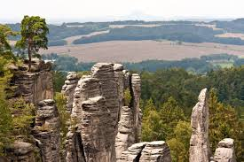
Czechia in a few words
Population – 10,5 million people
Area – 78 866 ${km}^{2}$
Currency – Czech crown (0,04 euro)
Founded – 103 years ago (1918)
Neighbours – Germany, Poland, Slovakia, Austria
Capital: Prague
Temperate climate, hot summers
and cold winters

Slide 4
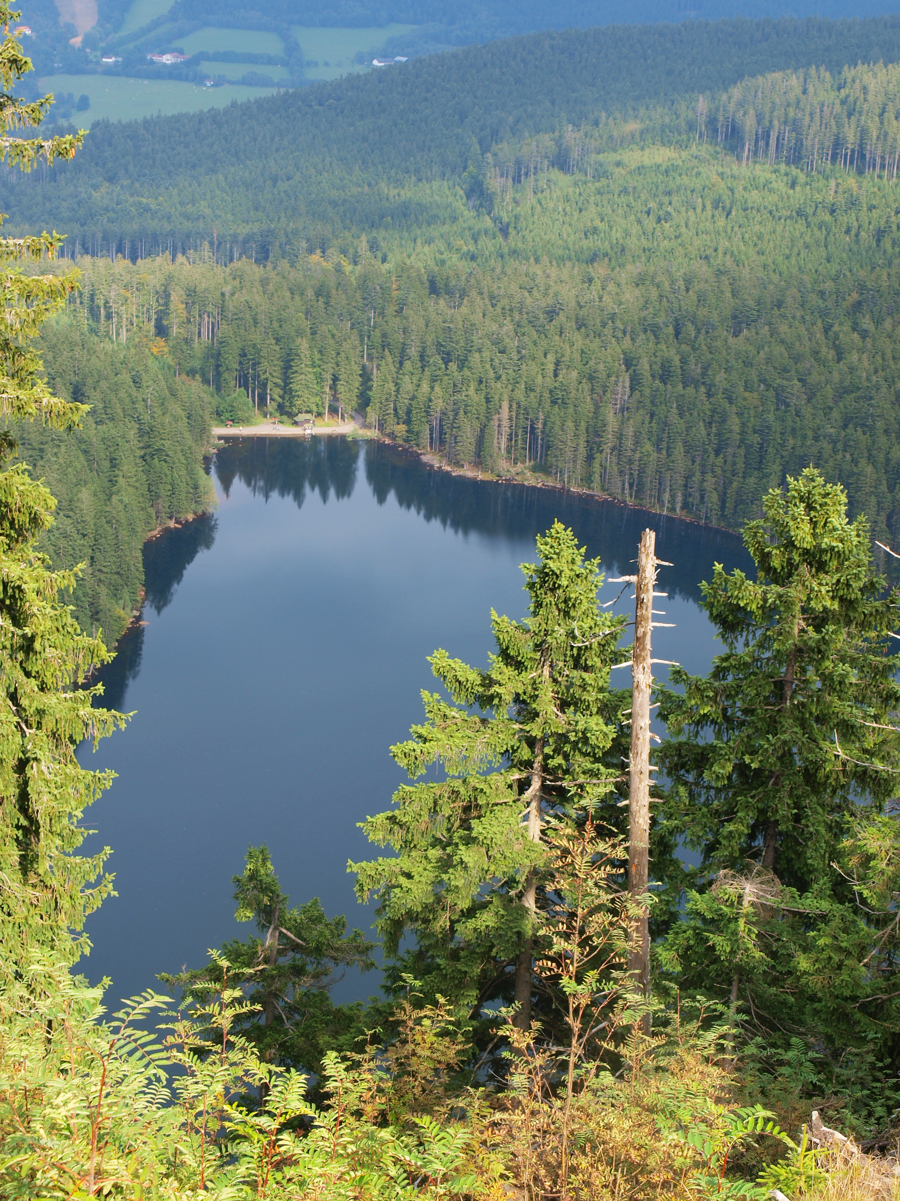
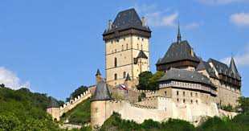
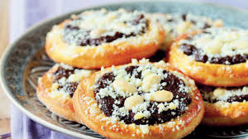
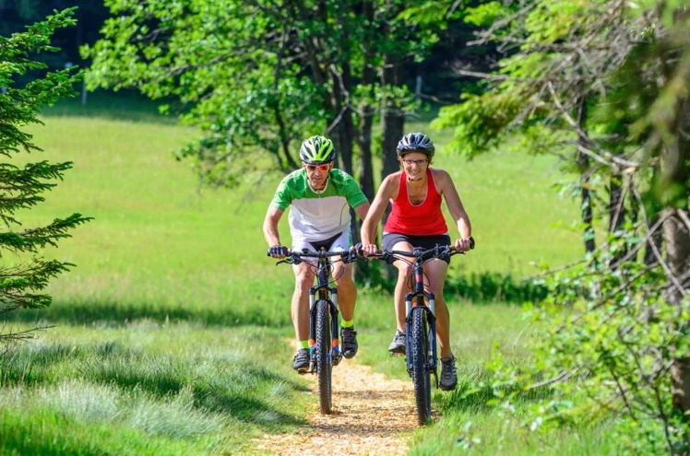
Czechia, the country of:
historical towns and medieval castles (over 1800)
green rolling hills, forests and many lakes (over 70)
traditional cakes and delicious dumplings
exciting outdoor activities (walking, cycling, canoeing, rafting, rope parks, cross country skiing)

Slide 5
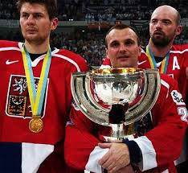
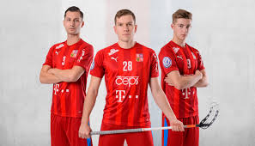
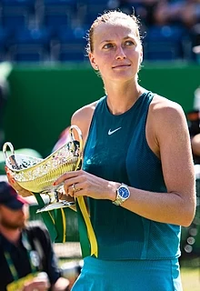
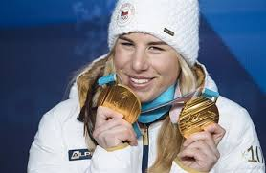
In Czechia we love sport…
Ice hockey
- gold medal at Nagano Olympic Games (1998)
- World championship winners (1999-2001)
Skiing
- downhill, snowboarding (Ester Ledecká winning Winter Olympics in both sports in 2018)
Athletics
- Decathlon (Roman Šebrle won 26 medals in decathlon and heptathlon)
Tennis
- Wimbledon (Petra Kvitová won it in 2011 and 2014)
Floorball
- Czechia has the fourth most successful team in the world

Slide 6
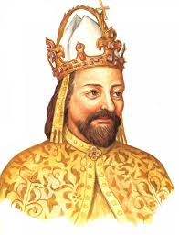
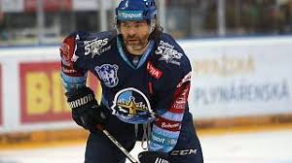
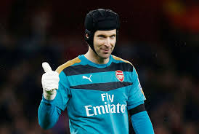
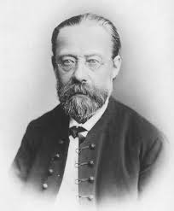
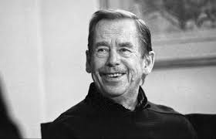
Famous Czech people
Jaromír Jágr,
famous ice-hockey player
Karel IV., great king
of the 15th century
Petr Čech, football goalkeeper in Chelsea
Václav Havel, playwright, the first president
after the fall of communism
Bedřich Smetana,
music composer

Slide 7
Prague, the capital
Founded in 723
Population: 1.3 million
Political, cultural and economic centre of Central Europe
Since 1992 the historical centre of Prague has been included in the UNESCO list
Home of the government and the president of the Czech Republic

Slide 8
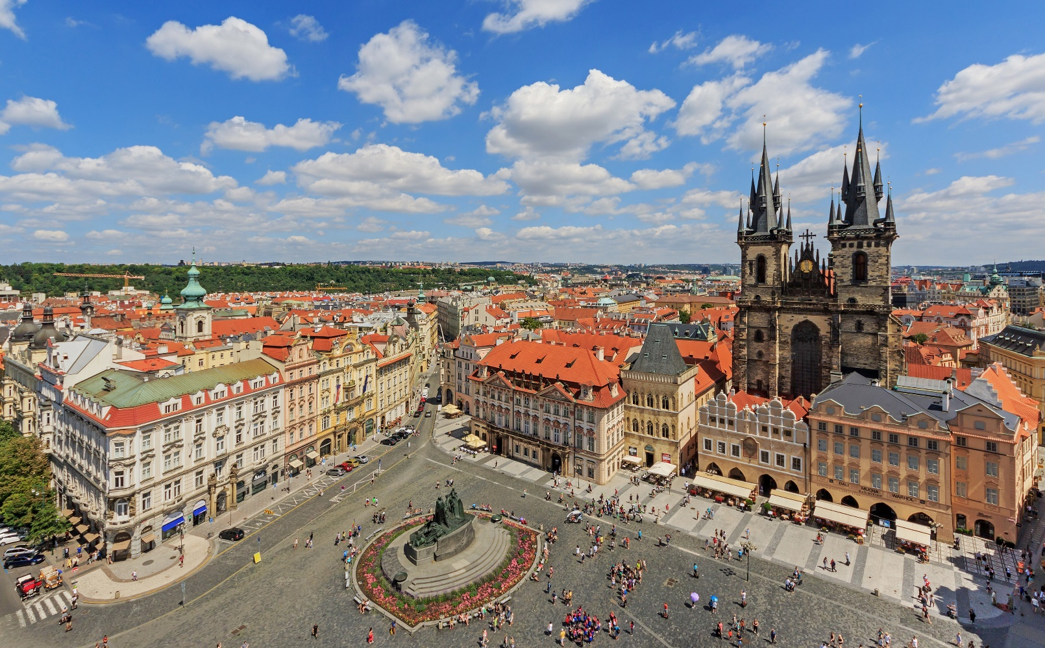
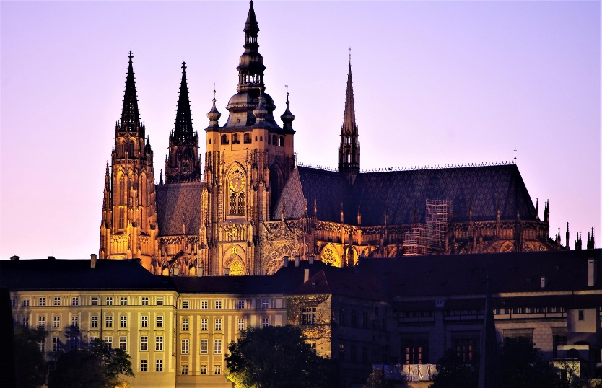
Cultural and historical sights and must see places
St. Wenceslaus Square and the National Museum
Prague Castle
Old Town Square

Slide 9
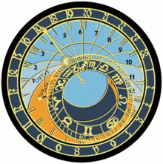
Prague astronomical clock
Made in 1410
Creator: Mikuláš of Kadaň
The only clock in the world, that can measure babylonian and old bohemian time
The oldest astronomical clock in the world

Slide 10
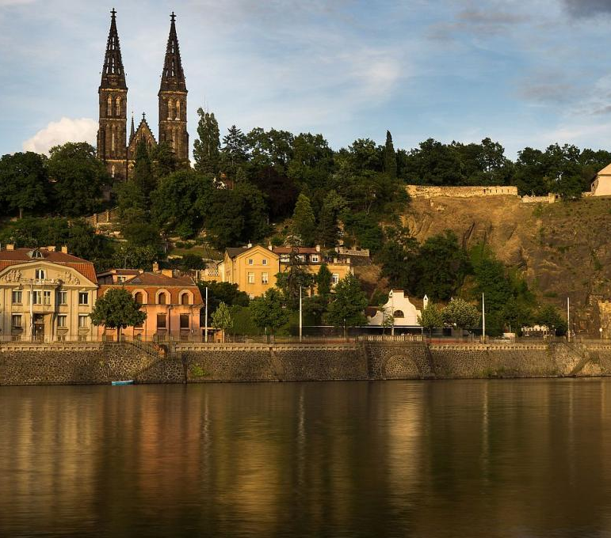
Vyšehrad and story of the Queen Libuše
Libuše was the clever daughter of King Krok
From Vyšehrad Castle Libuše predicted what Prague would look like and how famous it would be in the future.
She said: ´I can see a great city whose glory touches the stars.´

Slide 11
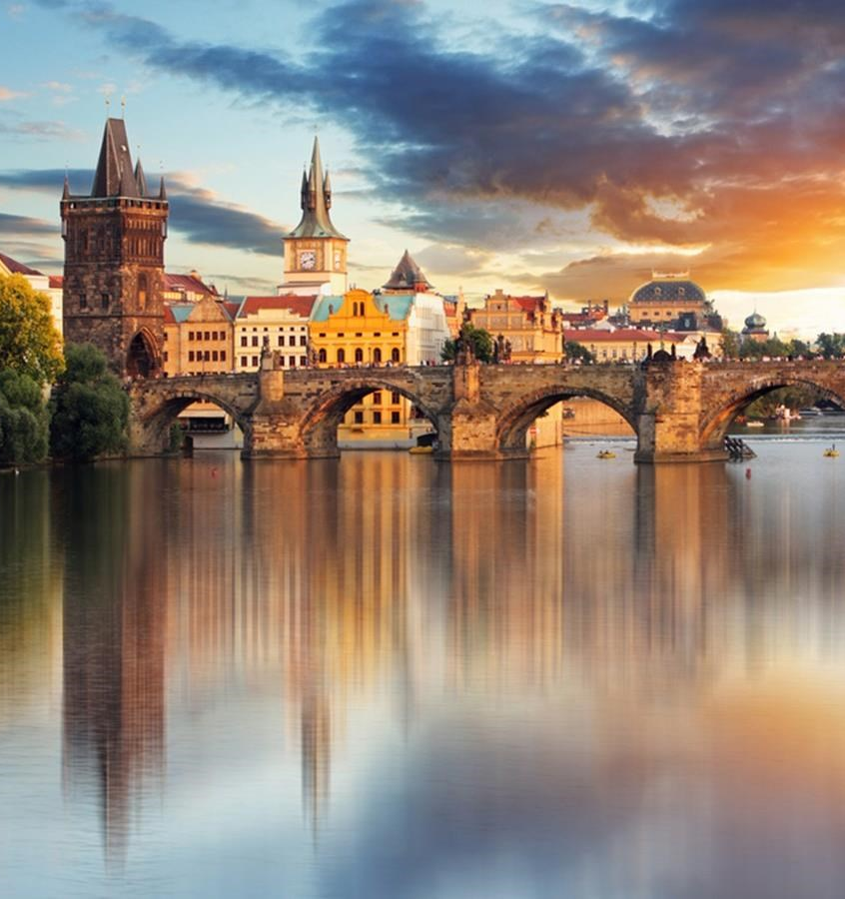
Charles Bridge
Charles Bridge was built by King Charles IV.
He was the most famous king in our history
According to legend, Charles Bridge was constructed using eggs and milk

Slide 12
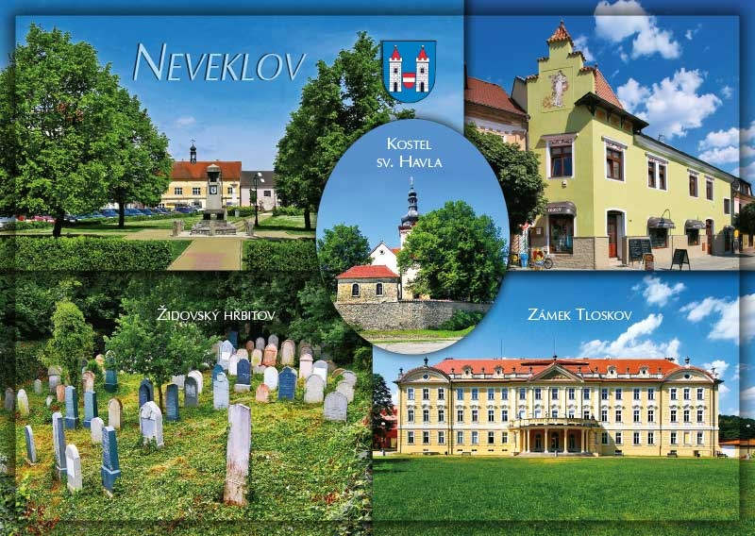
Neveklov, our town
The town of Neveklov is located in the district of Benešov,
40km south of Prague
The first written mention of the town
is from 1285
During World War II, the town became part of a German army military training ground and its inhabitants were forced to move out of their homes
Today, 2,700 people live in Neveklov and the surrounding villages

Slide 13
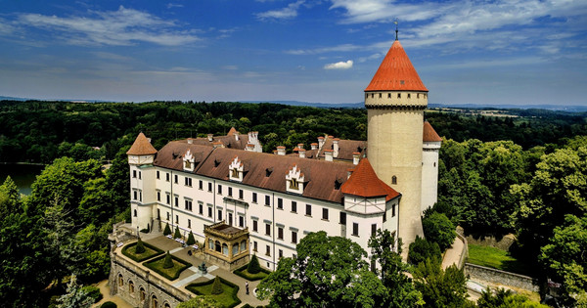
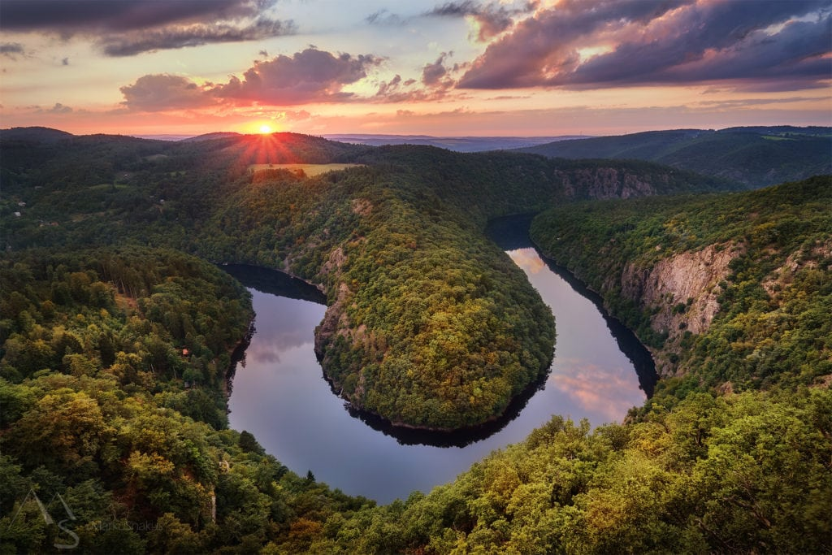
Interesting places in our area
Konopiště Castle
Former home of Franz Ferdinand d´Este, who would have been the next emperor of Austro-Hungarian Empire, but he was killed in Sarajevo which started the 1st World War
Blaník hill
A famous legend says that inside the hill rests awaiting army of soldiers
who will come to save the Czech nation when in need
Viewpoint Máj
One of the most famous views of the meandering Vltava River

Slide 14
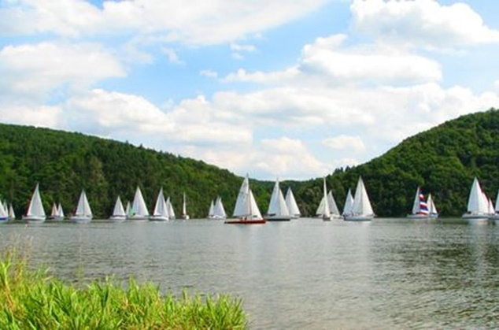
Slapy lake
This water reservoir is part of the Vltava river.
It is the sixth largest lake in Czechia.
Depth: 58 meters.
The dam wall was built in 1955
Popular recreational area for watersports and activities (swimming, boating, paddleboarding, fishing,etc.)

Slide 15
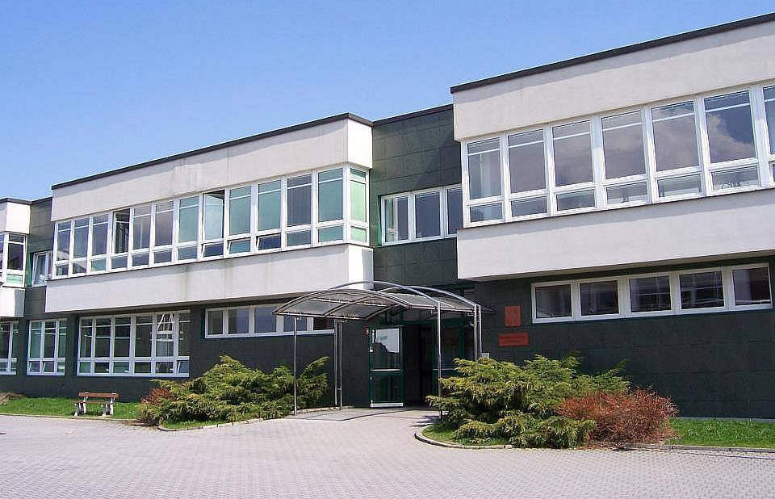
Our school
Business Academy of Neveklov

Slide 16
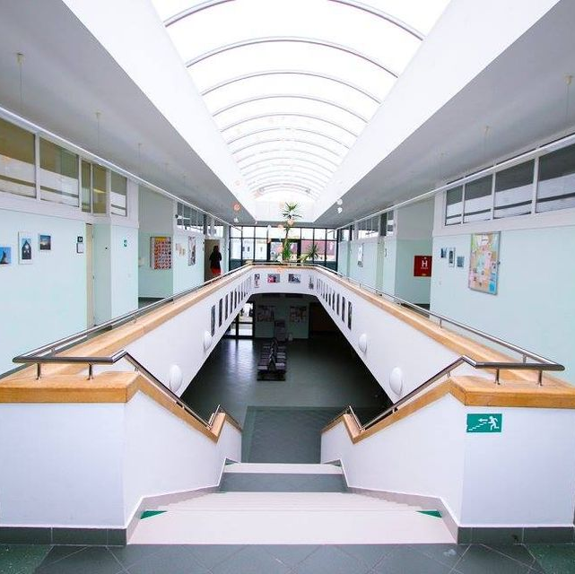
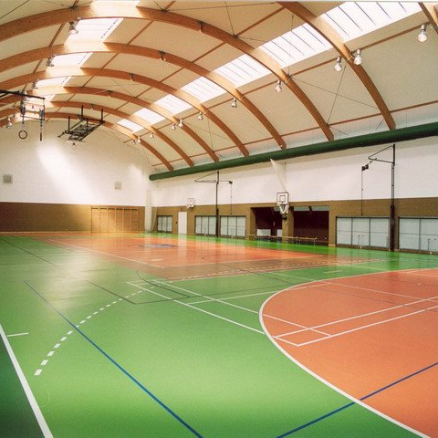
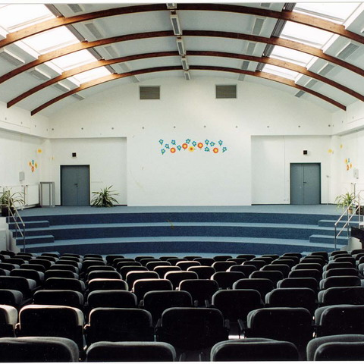
Small but modern
120 students and 20 teachers
The students can study 3 languages – English, German and Russian.
Students can apply for a variety of certificates: international foreign languages, professional massage course, economics.
Modern campus includes dorms, a big sports hall and sports ground, and a school cafeteria.
We have rooms with computer technology, workrooms equipped with music systems, video projectors and televisions.
There is wifi in all the buildings.

Slide 17
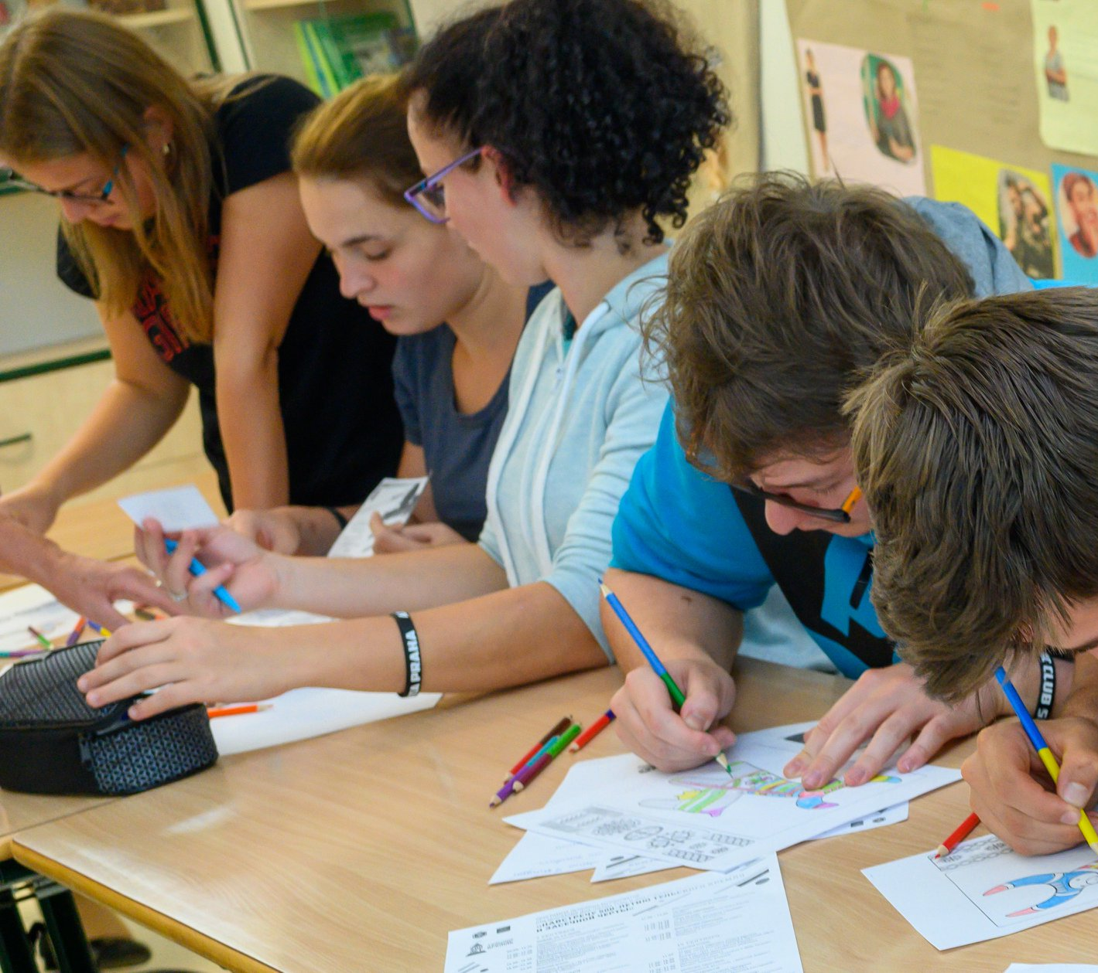
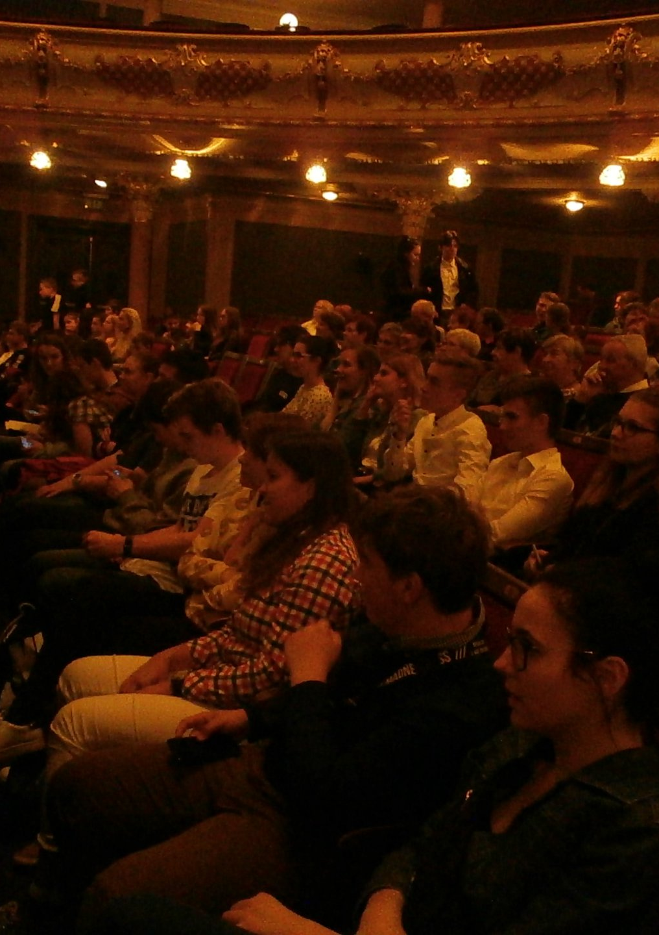
Students can choose from four study fields
Economical lyceum
- prepares pupils for studying at universities, preferably with an economic focus or at higher vocational schools.
Foreign languages
- students can specialize in the field of international trade, business practices and economics, which deals with hotel operations, pricing, hotel management and marketing, catering services, insurance and tourism.

Slide 18
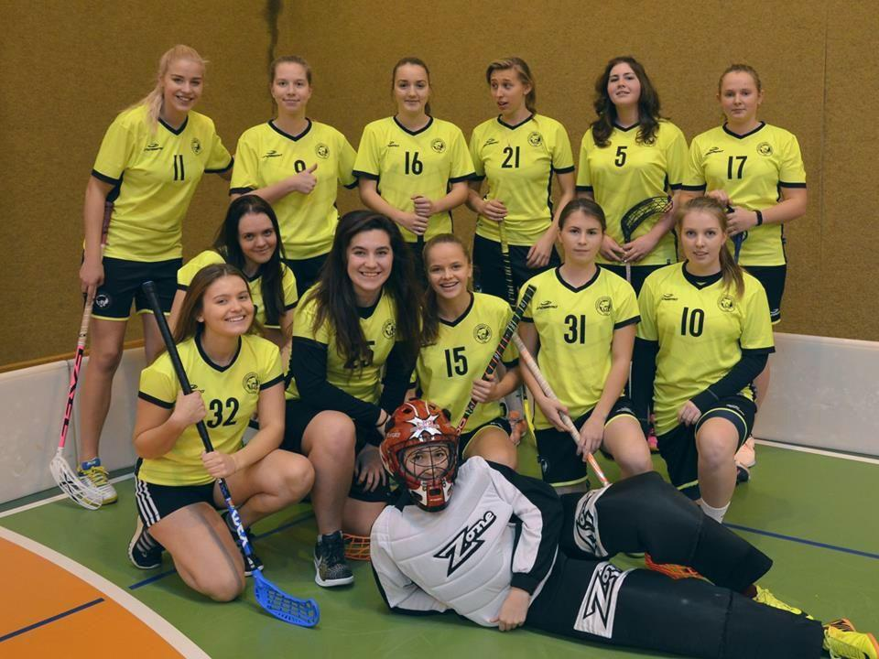
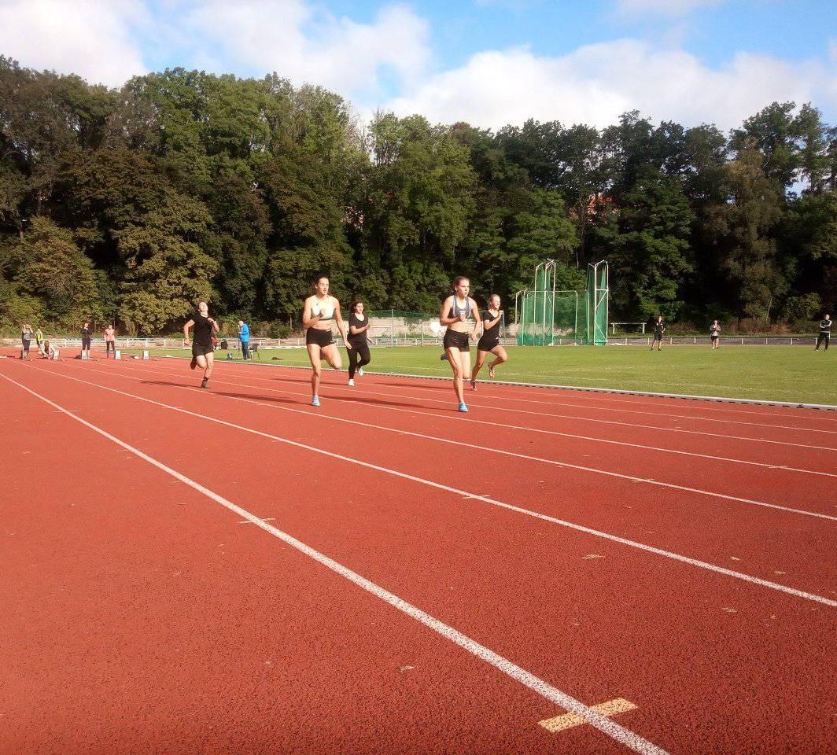
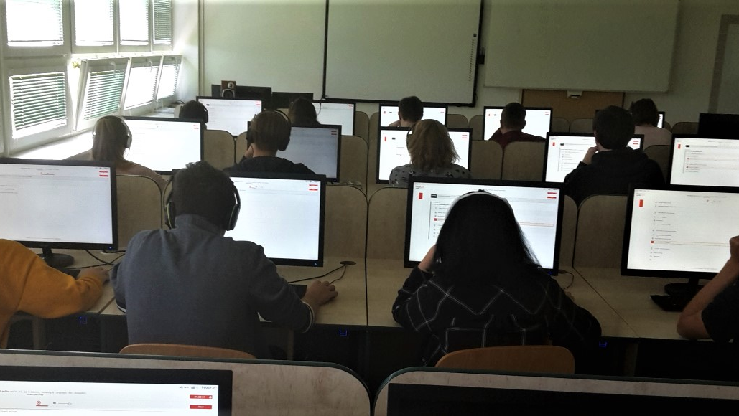
Sports management
The study combines knowledge from the field of economic related theory and business in sport.
Informatics
In this field students learn more about information technologies, graphic design etc. combined with business knowledge.

Slide 19
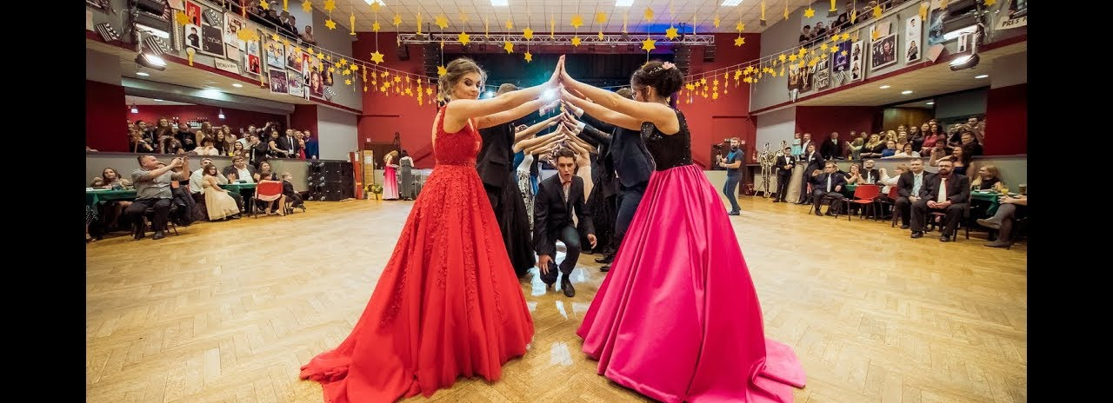
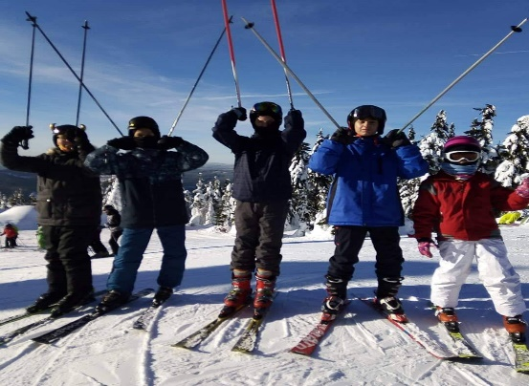
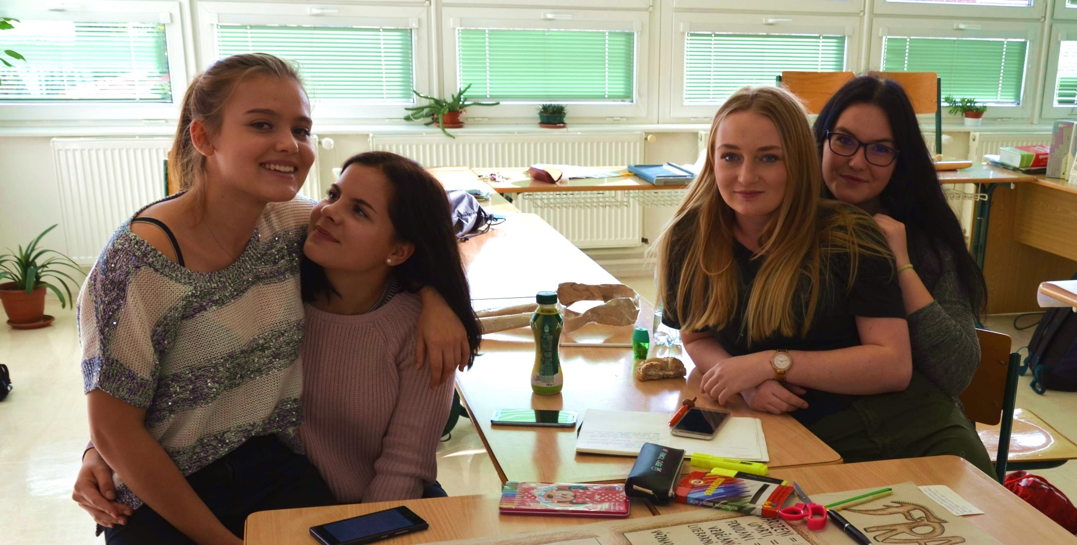
Activities at our school
Every year our students and graduates organize a prom and other events.
Our school send students to ski and other sport courses (canoeing, cycling, sports activities)
There is a students group DOORS which organizes a lot of events (charities, environmental help, for a local community)
And we look forward to taking part in the Erasmus project!

