Slide 1
OA Neveklov
Founded - 20.11.1997
Included in the network of schools - 19.03.1998

Slide 2
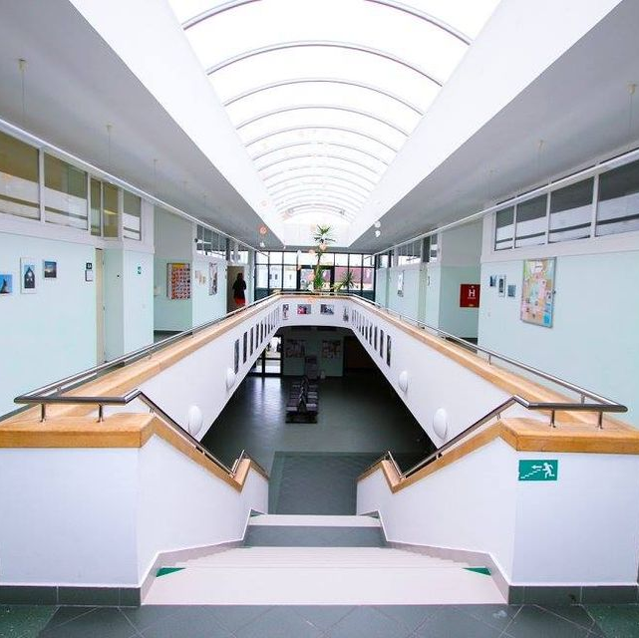
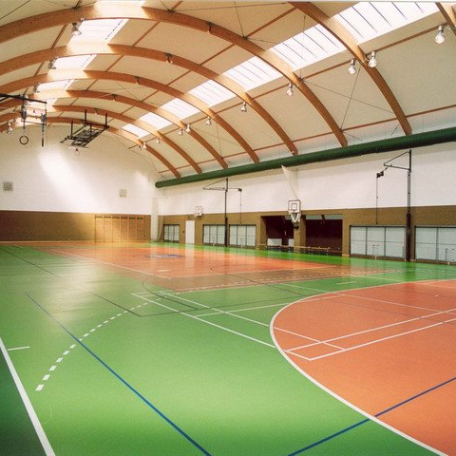
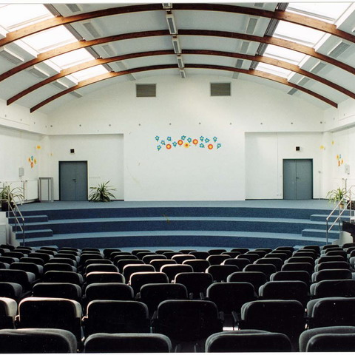
Modern school equipment
Part of a modern campus.
Includes a youth home, a sports hall, and a school cafeteria.
Apartments for school staff.
3 rooms with computer technology.
Possibility to use PC for personal use.
Workrooms equipped with hi-fi tower, video recorder and television.
The subject of a fictitious company - the use of office equipment and computer technology.
Refreshments at school - vending machines with baguettes, biscuits and chocolate products, vending machines for hot and cold drinks and a buffet.
1 picture – Hall, 2 picture – IT room, 3 picture – Gym, 4 picture auditorium

Slide 3
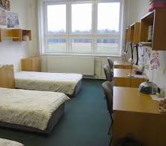
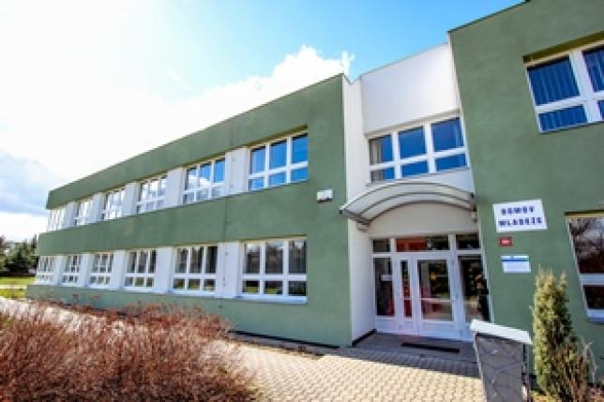
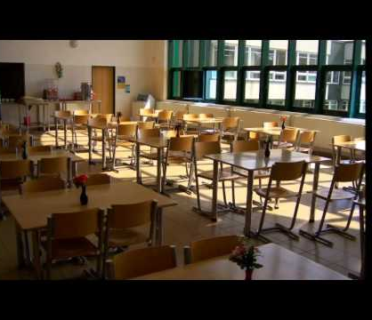
Youth home
Operates from Sunday to Friday.
Building has an atrium, club rooms, triple rooms with kitchen and accessories, laundry room, gym and computer room.
All-day meals for residents of youth home are provided by the school cafeteria.
Lunches for students of the schoool are provided by the school cafeteria also.
1 picture – room in youth home, 2 picture – youth home, 3 picture - cafeteria

Slide 4
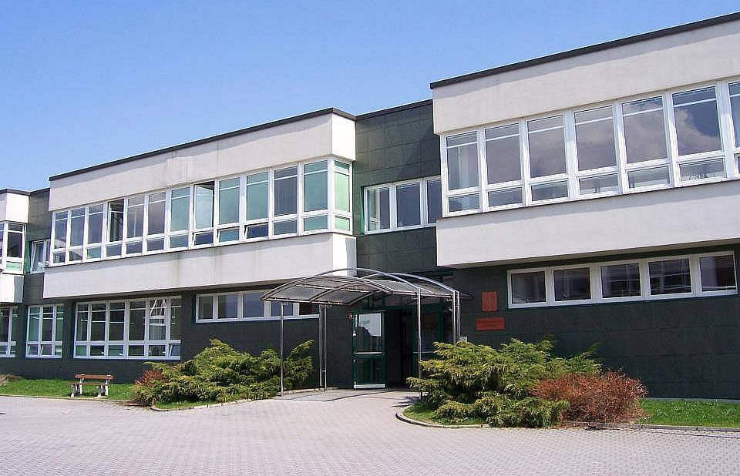
STUDY FIELDS
What can you study?

Slide 5
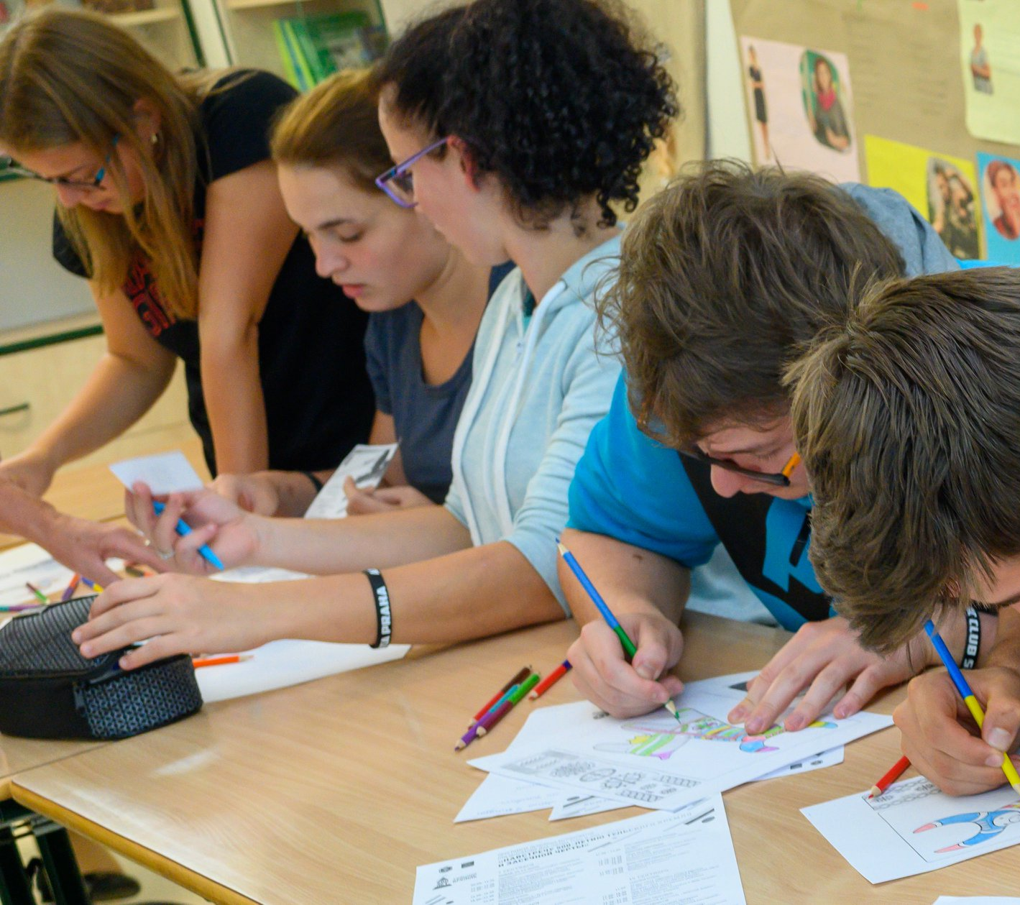
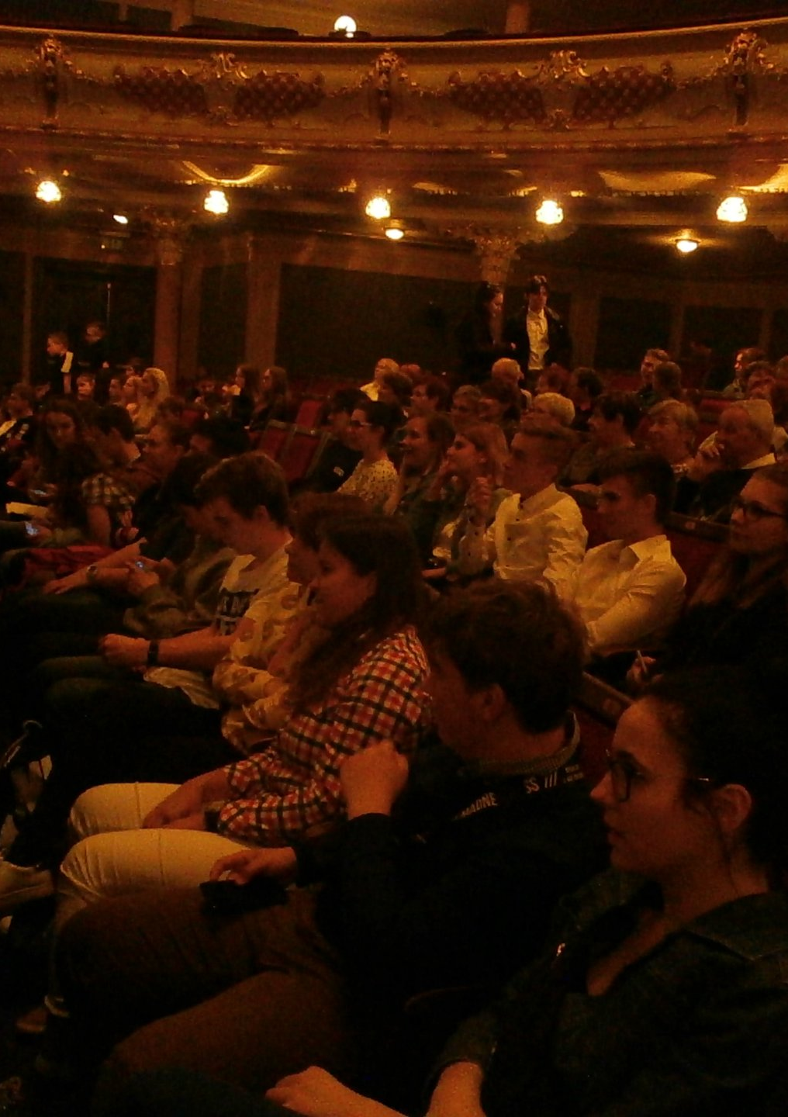
Economic Lyceum
It is a four-year field of study with a high school diploma, which aims to prepare pupils for study at universities, preferably with an economic focus, or at higher vocational schools.

Slide 6
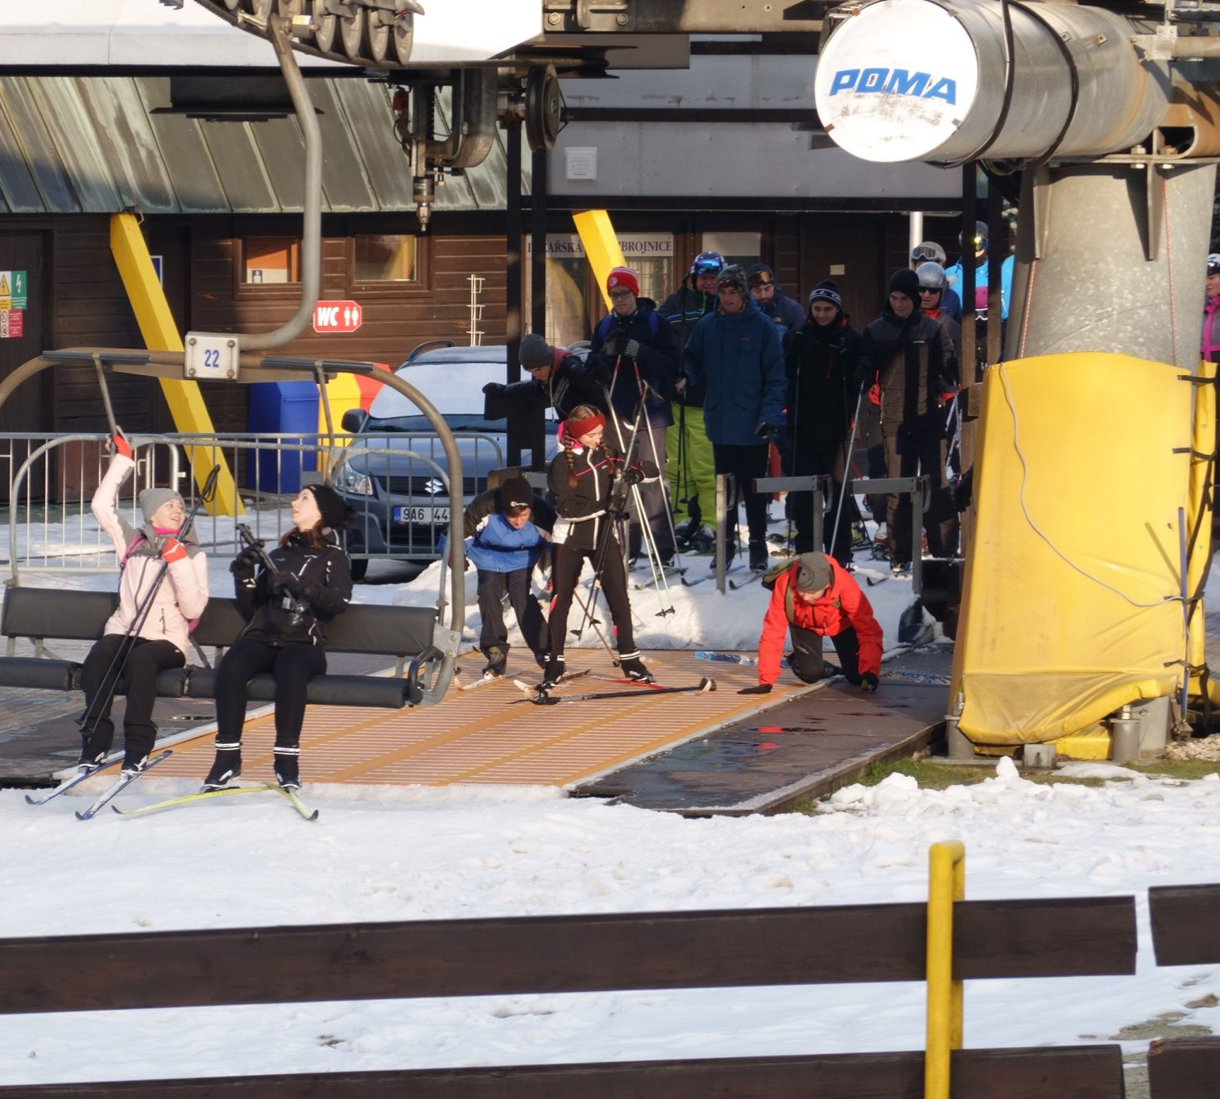
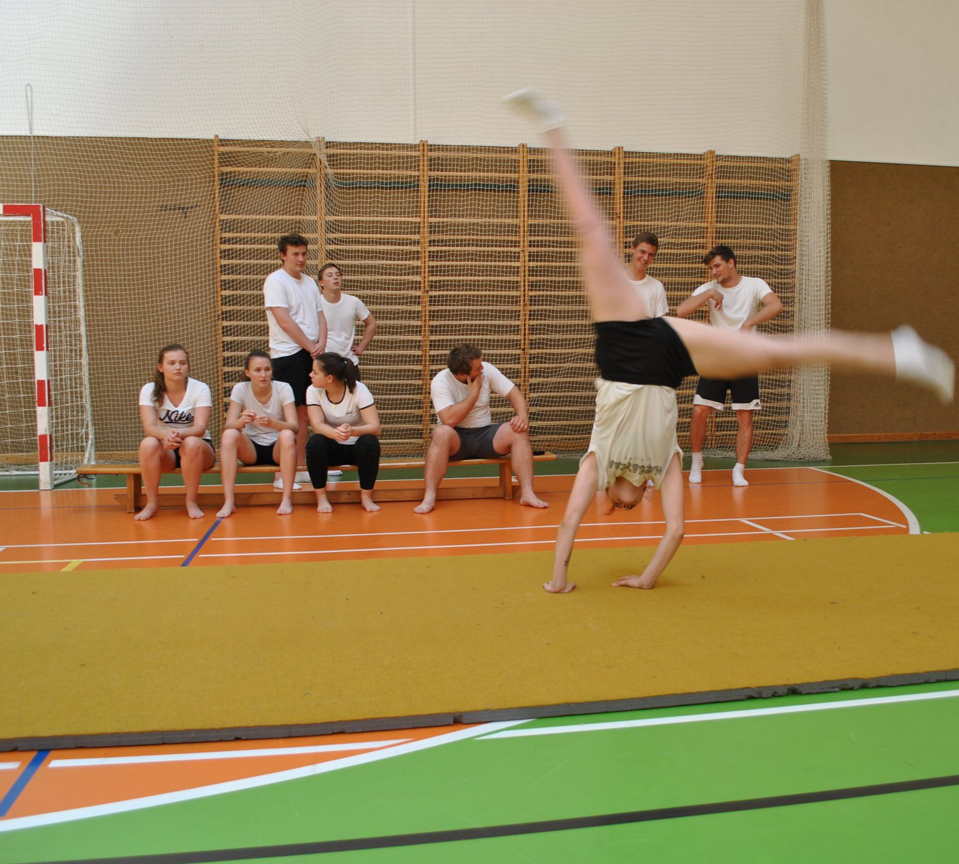
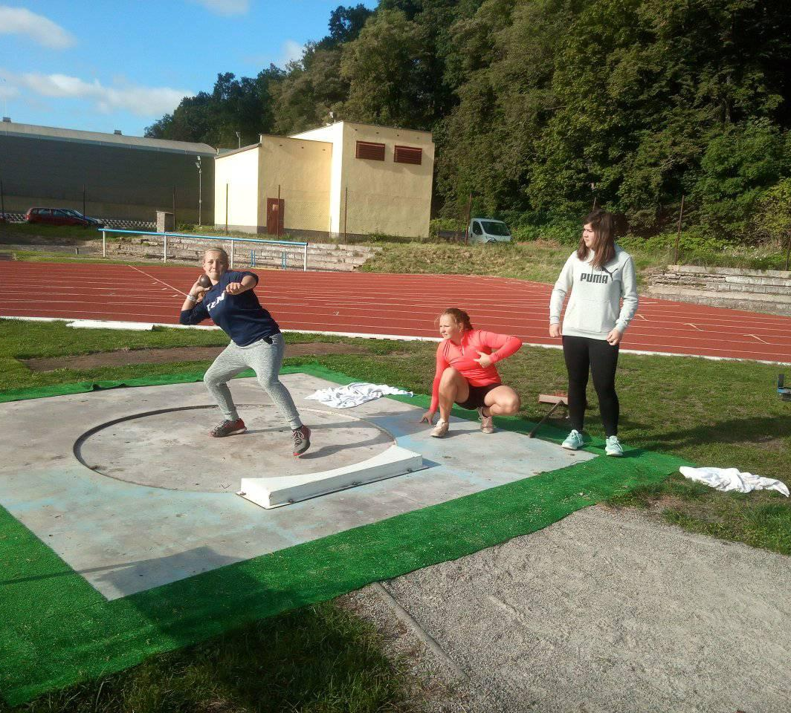
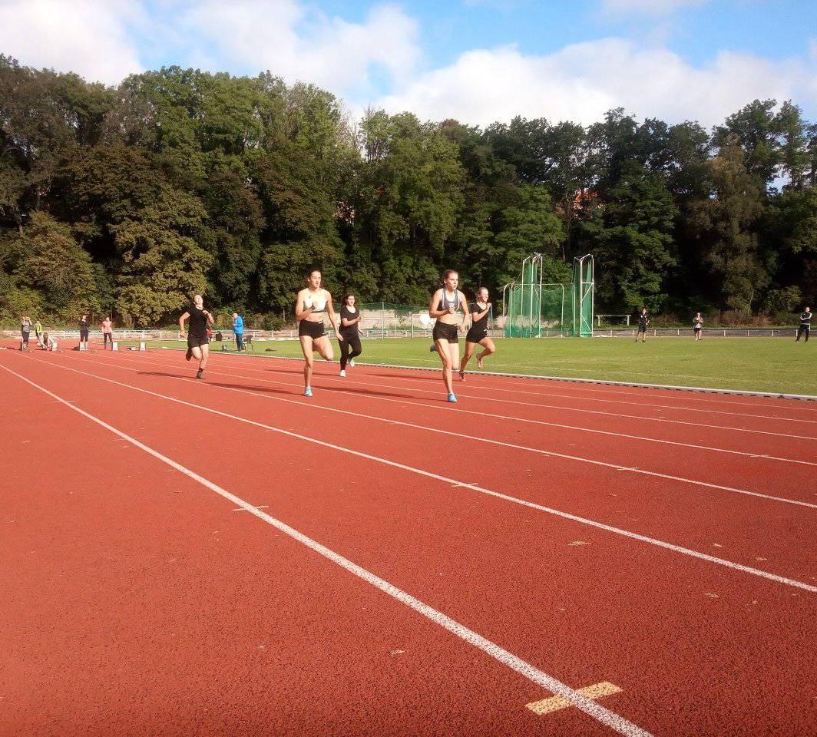
Economics and business - sports management
The study of this field combines knowledge from the field of economic-business with knowledge related to theory and business in sport.

Slide 7
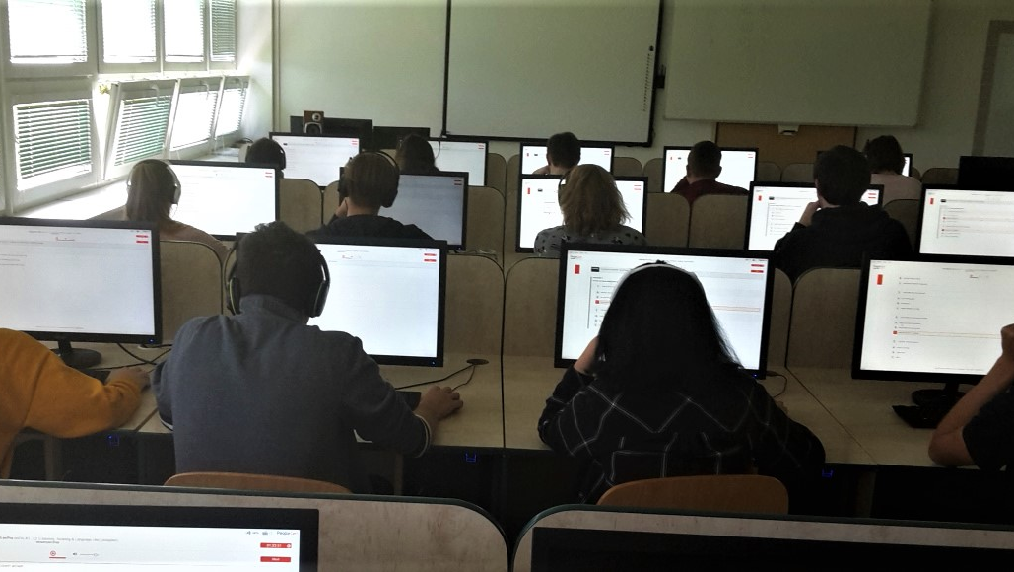
Business Academy - focus on foreign languages
Business Academy - specialization in informatics
Within these fields, the school enables students to specialize in the field of international trade, which includes issues of trade policy, customs, export and import trade operations, business practices and service economics, which deals with hotel operations, pricing, hotel management and marketing, catering services, insurance, tourism.

Slide 8
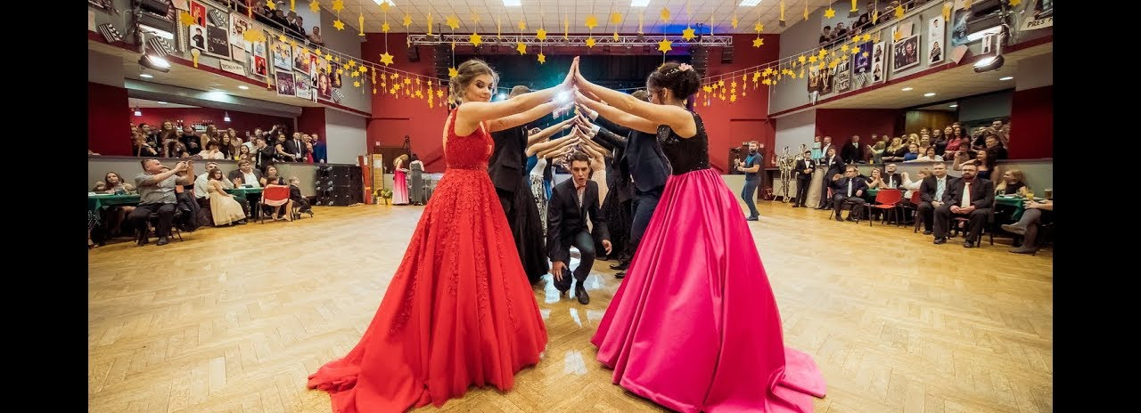
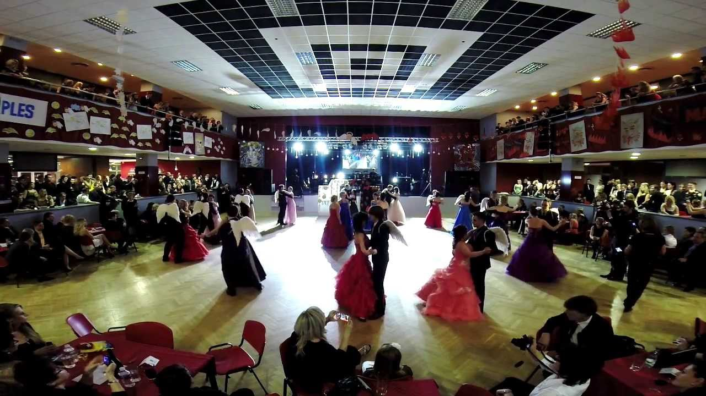
We allow applicants to pass the following exams:
State exams in office writing
State exams in word processing on a PC
International exams in foreign languages
After graduation, students apply to study at universities and colleges.
Massage course - professional qualifications
This photo shows what prom is like.

Slide 9
Placement of graduates 2019-20
Universities 13
Secondary 2
College / technical institute 0
Employment 15
Abroad 0
Unknown 7

Slide 10
Placement of graduates 2018-19
Universities 12
Secondary 1
College / technical institute 1
Language school 2
Employment 11
Abroad 0
Unknown 0

