Slide 1
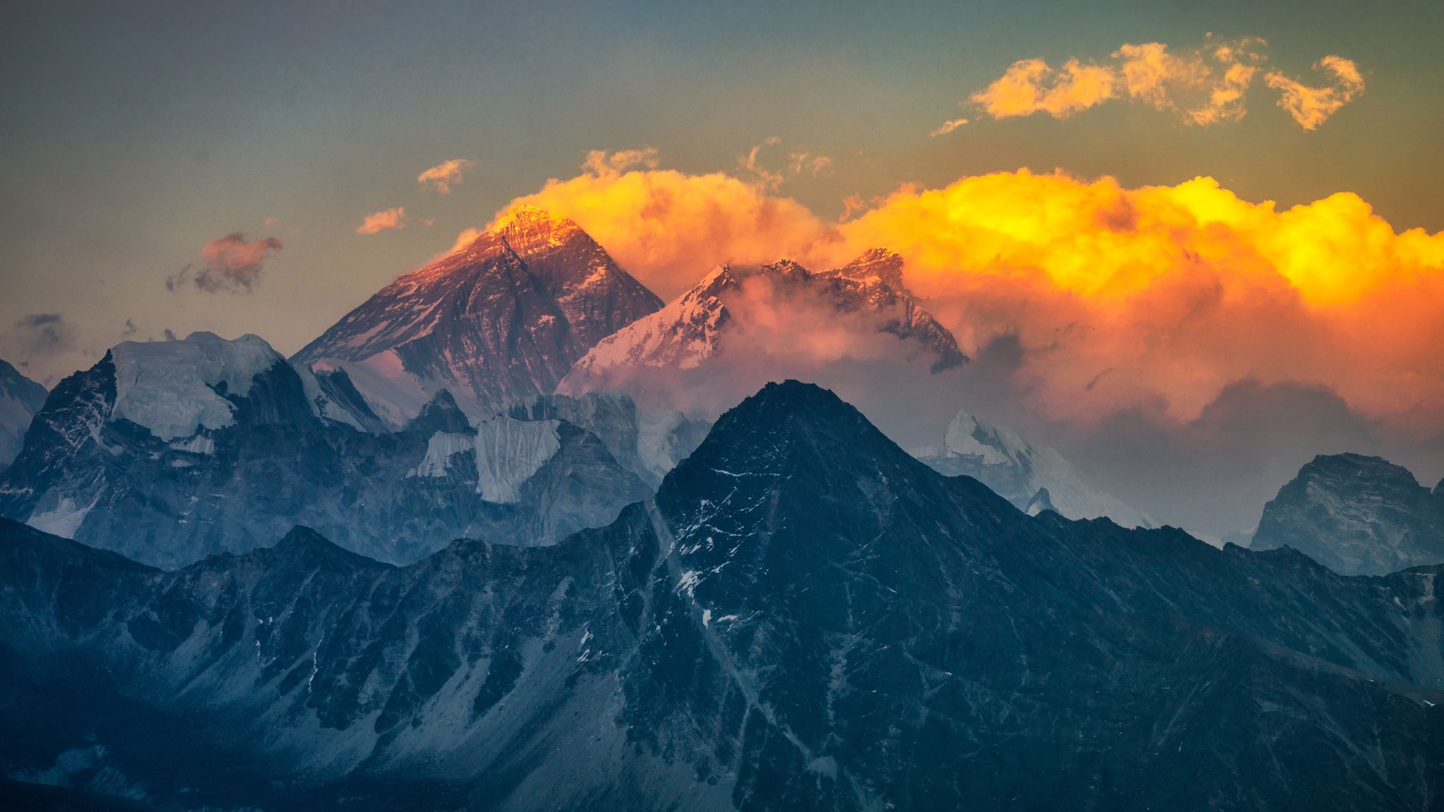
oUR Region

Slide 2
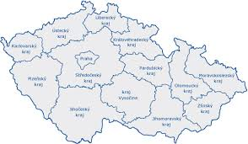
Regions in Czechia
14 regions
Each region has a county town
Capital City of Prague. - Prague
Central Bohemian Region. - Prague
Pilsen Region. - Pilsen

Slide 3
Where is our region?
In distance of 12 km easterly is town Benešov, 14 km south-westerly is town Sedlčany, 25 km westward is town Dobříšmand 27 km notherly is town Říčany
-Owestward from town flows Tloskovský brook
-There is a elementary school and medium school
-There is a watchtower Neštětická hill at Neveklov

Slide 4
History of Neveklov
· The town of Neveklov is located in the district of Benešov
· Approximately 2,700 live here
· The first written mention of the village is from 1285
· During World War II, the city became part of the military training ground of the SS Benešov and its inhabitants had to move out on December 31, 1943
On 10 October 2006, the municipality's status was restored

Slide 5
Interesting places
The capital city - 57 km
Slapy - Dam
Konopiště - a castle in the Romanesque style
Blaník - The highest point of the Podblanicko area - The most famous legend tells that inside the mountain rests an armythe army is waiting for it to be the worst for the Czech nation
View Máj - One of the most famous views of the meanders (horseshoe) of the Vltava River
Church of St. Barbora in Kutná Hora - UNESCO list

Slide 6
Slapy reservoir
It is a dam reservoir on the Vltava river.
According to its area, it is the sixth largest dam in the Czech Republic.
Its depth is 58 meters. The water level is located 271 meters above sea level.
The dam would be built as part of the Vltava cascade in the years 1949-1955.

Slide 7
END
.Authors : Šejblová, Osovská, Mašková, Riegerová, Márovcová

