Slide 1
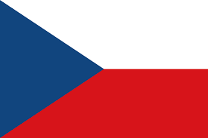
Czech Republic
Small country in the heart of Europe

Slide 2
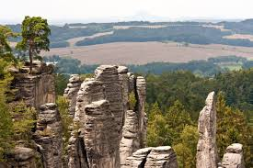
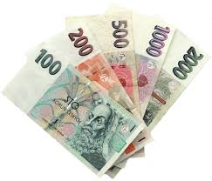
About Czechia in a few words
Capital city – Prague (1,2 mil. people)
Population – 10,5 million people
Area – 78 866 ${km}^{2}$
Currency – Czech crown (0,04 euro)
Age – 103 years (1918)
Neighbours – Germany, Poland, Slovakia, Austria

Slide 3
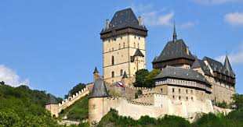
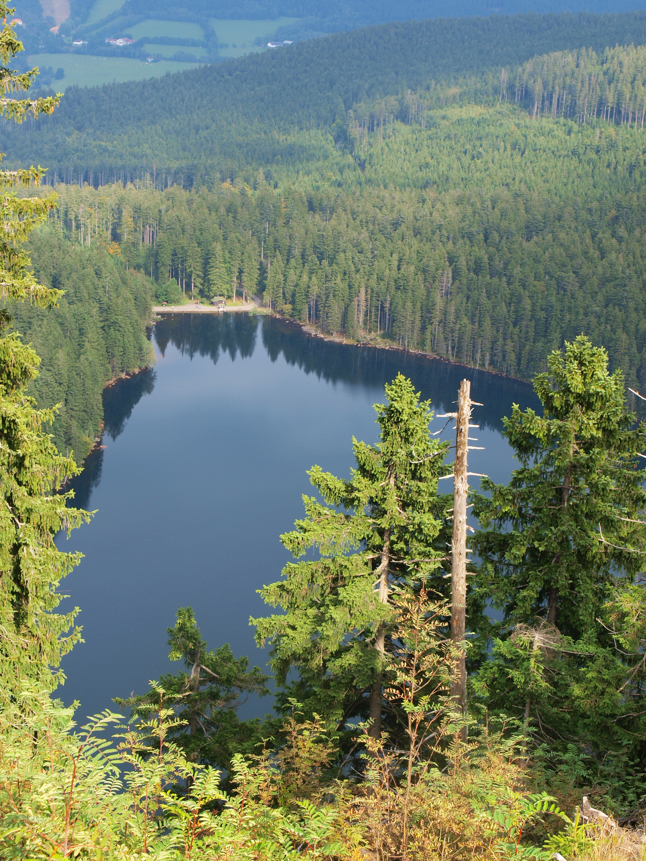
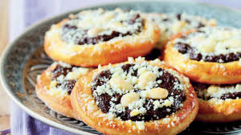
Czechia, the country of:
historical towns and medieval castles (over 1800)
green rolling hills, forests and many lakes (over 70)
exciting outdoor activities (walking, canoeing, rafting, rope parks, cross country skiing)
tradicional sweet cakes and delicious dumplings
famous beer (141 liter per capita per year)

Slide 4
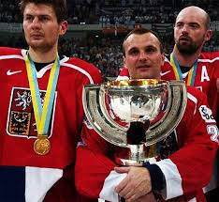
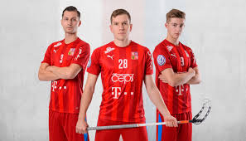
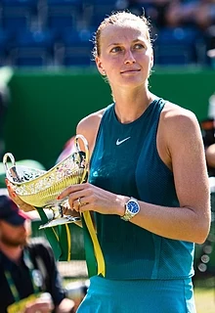
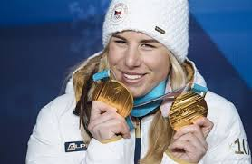
Sport in Czechia
Ice hockey:
- gold medal in Nagano Olympic Games (1998)
World championship winners (1999-2001)
Skiing:
- downhill, snowboarding (Ester Ledecká winning Winter Olympics in both sports in 2018)
Athletics:
- Decathlon (Roman Šebrle won 26 medals in decathlon and heptathlon)
Tennis:
- Wimbledon (Petra Kvitová won it in 2011 and 2014)
Floorball:
- Czechia has the fourth most successful team in the world

Slide 5
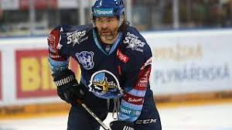
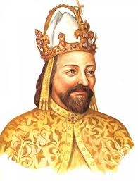
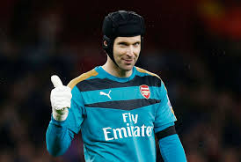
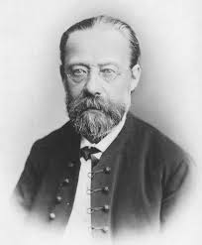
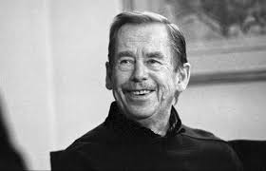
Famous Czech people
Jaromír Jágr – famous ice hockey player
Petr Čech – football goalkeeper in Chelsea
Karel IV. – great king of the 15th century
Bedřich Smetana – national opera composer
Václav Havel – playwright and disident who became the first president after the fall of communism

